Slide 1
COMPUTER ORGANISATION
INSTRUCTIONS CODE IN COMPUTER ORGANISTION

Slide 2
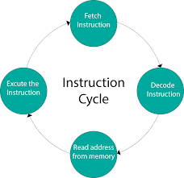
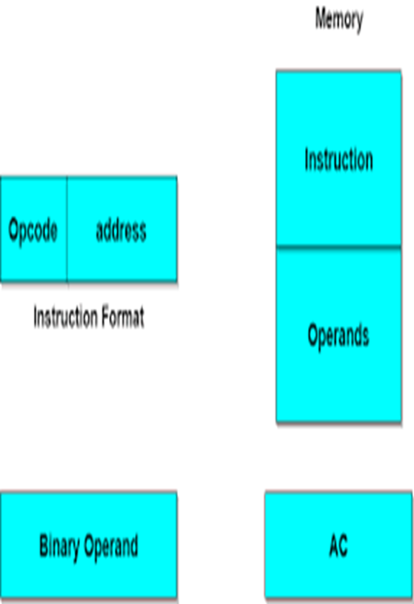
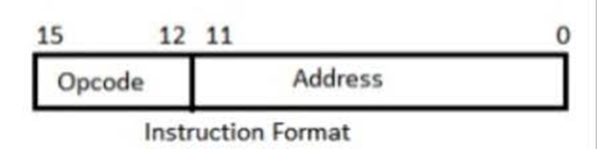
What Are Instruction Codes?
While a Program, as we all know, is, A set of instructions that specify the operations, operands, and the sequence by which processing has to occur. An instruction code is a group of bits that tells the computer to perform a specific operation part.

Slide 3

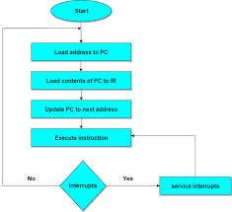
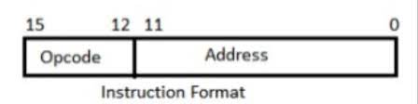
Instructions Codes In Computer Organisation

Slide 4
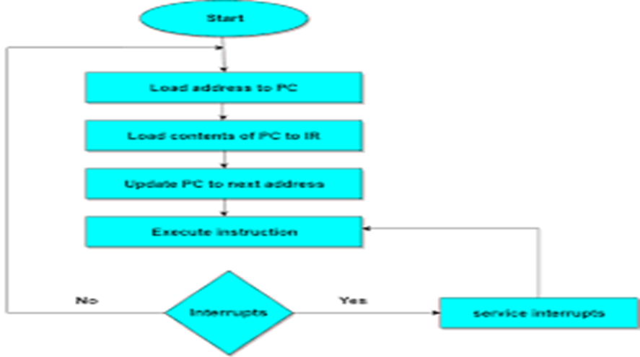
Instruction Code: Operation Code
The operation code of an instruction is a group of bits that define operations such as add, subtract, multiply, shift and compliment. The number of bits required for the operation code depends upon the total number of operations available on the computer. The operation code must consist of at least n bits for a given 2^n operations. The operation part of an instruction code specifies the operation to be performed.

Slide 5


Instruction Code: Register Part
The operation must be performed on the data stored in registers. An instruction code therefore specifies not only operations to be performed but also the registers where the operands(data) will be found as well as the registers where the result has to be stored.

Slide 6


